Slide 1
Infrastructure for the DBA: An Introduction
Peter Shore
SQL Saturday Chicago 2016

Slide 2
Agenda
Introduction
Network Terms
Network Devices
Network Services
Server Hardware
Server Storage
Attached Server Storage
Virtualization
Cloud
Active Directory
Windows Server

Slide 3
Who am I?
Platform Database Consultant – BlueChip Consulting Group
Intentionally Accidental DBA
Over 20 years IT experience
Server Engineer
Desktop Engineer
Network Infrastructure
Desk side support
President CBusPASS
Member Multiple Virtual Chapters
How to find me
Twitter: @pshore73
E-mail: pshore73@outlook.com
Blog: http://shoresql.wordpress.com

Slide 4
Network Terms
LAN
Local Area Network
Computer network connecting computers in a limited area
House
School
Office
WAN
Wide Area Network
Communication network extended over a wide area
Multiple data centers
Internet
VLAN
Virtual Local Area Network
Not limited to hypervisor environments
“Any broadcast domain that is partitioned & isolated in a computer network at the data link layer (OSI Layer2)”
Partition traffic
Partition security
Does not expand bandwidth
Bandwidth vs. Latency
Bandwidth – maximum throughput
Latency – delay from input to outcome

Slide 5
Network Devices
Hub
Single broadcast domain
Single Segment
Mostly retired
No commercial production beyond 100Mbps
Switch
“Switches create networks” - Cisco
Each port is a broadcast domain
Managed vs. Unmanaged
Multi-segment
Available to 10 Gbps
Router
Determines next network point a packet should be forwarded
“Routers connect networks” - Cisco

Slide 6
Network Services
Dynamic Host Configuration Protocol (DHCP)
Delivers TCP/IP configuration
Automatic assignment of address to end-points
TCP/IP Address
Subnet Mask
Default Gateway
Allocated by time, known as a lease
Domain Name Services (DNS)
“Phonebook” of Names to TCP/IP addresses
Address Records (A Records)
Record linking address to name
Canonical Name (C Name)
Reference or redirection
Mail Exchanger (MX Record)
Identifies a mail server

Slide 7
Wires vs. Radios
Wired
Wireless
Pros
Tier by tier higher speed
More secure
Better for data centers
Cons
Lacks flexibility
Installation cost
Pros
Flexible
Enables BYOD
Relatively lower installation cost
Cons
Tier by tier speeds lower
Security weaknesses

Slide 8
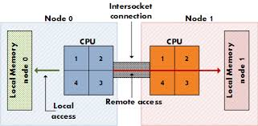
Server Hardware
Server/Host/Blade
Central Processing Unit (CPU)
Cores
Hyper-threading
Memory (RAM)
Random Access Memory
Non-Uniform Memory Access (NUMA)

Slide 9
Server Storage
Local Storage
Controller in server
Disk in server
Configured at server level
Typically in Redundant Array of Inexpensive Disks (RAID)
RAID 0 – striping no parity
RAID 1 – mirror
RAID 5 – striping with parity
RAID 10 – mirror of stripes
Peripheral Component Interconnect Express (PCIe)
Slot on motherboard
PCIe flash disk (example FusionIO)

Slide 10
Attached Server Storage
External to physical server
Behavioral nuances differ by vendor
Often used in conjunction with blade style server
Often used in virtual environments
Network Attached Storage (NAS)
Connection to NAS Server (aka NAS head)
Server connects to disk array
Storage Attached Network (SAN)
Connection to storage via Host Bus Adapter
Fibre channel dedicated hardware
iSCSI over LAN
Behaves more like on-board attached storage

Slide 11
Virtualization
All most all SQL Server work loads can be virtualized
Biggest factor is hardware
Must be properly configured
Creates abstraction layer between Windows Server and hardware
Virtualization layer controls access to physical hardware
Host level memory pressure may require minimum memory setting
Viable part of High Availability solution, but not the whole solution
Backup approach can be an issue

Slide 12
Cloud
Someone else’s datacenter
Infrastructure as a Service (IaaS)
Virtualized servers
Can replace most or all infrastructure
Platform as a Service (PaaS)
Geared toward software development
Backend systems
Does not replace on-site infrastructure
Software as a Service (SaaS)
Productivity software

Slide 13
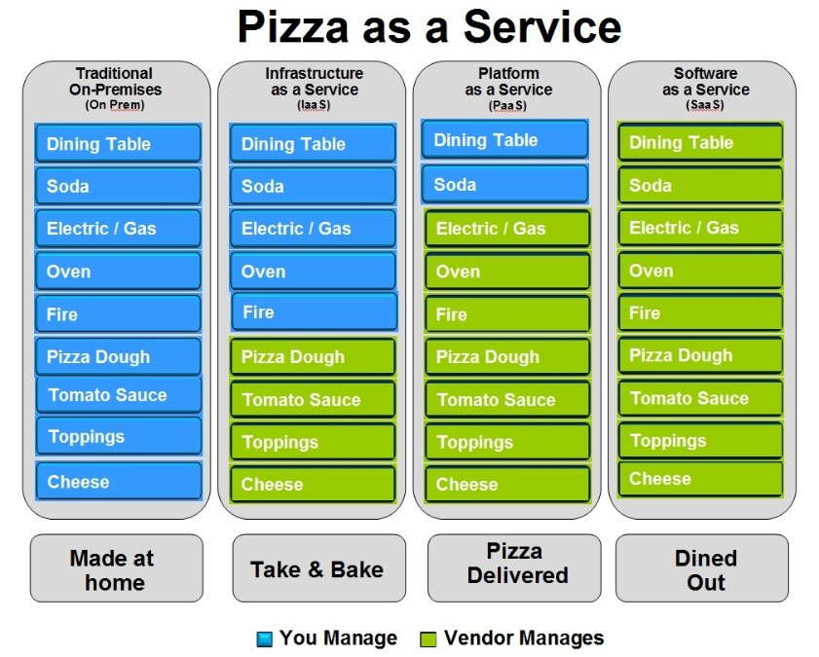
Cloud

Slide 14
Active Directory
Microsoft implementation of Lightweight Directory Access Protocol (LDAP)
Hierarchical database
Objects organized by Organization Units
SQL Servers separated out
Service accounts separated out & grouped
Group Policy
“Group Policy is an infrastructure that allows you to implement specific configurations for users and computers. Group Policy settings are contained in Group Policy objects (GPOs), which are linked to the following Active Directory directory service containers: sites, domains, or organizational units (OUs).” (http://tinyurl.com/k368u74)

Slide 15
Active Directory
Managed Service Accounts
Complex passwords known only to account and Active Directory
Maintain Kerberos Service Principal Names (registering SPN http://tinyurl.com/zepmxpd)
Computer specific
Server 2008r2 with Active Directory Functional Level 2008r2 or higher
Group Managed Service Accounts
Used on multiple hosts
Not supported until SQL 2016

Slide 16
Windows Server
TCP Chimney Offload
Transfers workload from CPU to NIC during data transmission
Disable it can caused connectivity problems, designed for short lived connections
Group Polices in affect
GPResult /r
Create GPO
Lock pages in memory
Perform Volume Maintenance

Slide 17
Anti-Virus
Valid arguments to both sides
If implemented use Microsoft recommendations for exceptions
http://social.technet.microsoft.com/wiki/contents/articles/953.microsoft-anti-virus-exclusion-list.aspx

Slide 18
Questions?

